Slide 1
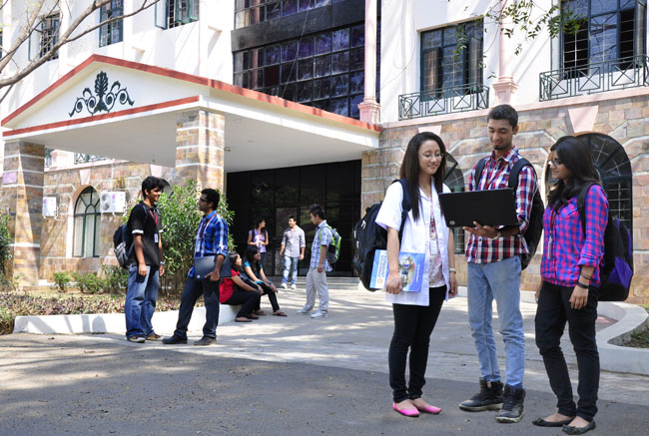

B.Tech Computer Science and Engineering – Ist Semester
Programming Language Concepts
Department of Computer Science and Engineering

Slide 2
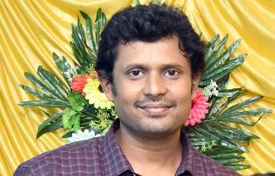
D.S.John Deva Prasanna, AP(SG)
Department of Computer Science and Engineering

Slide 3
What is a Programming Language?
A programming language is a formal language comprising a set of instructions that produce various kinds of output.
Programming languages are used in computer programming to implement algorithms.
Most programming languages consist of instructions for computers. There are programmable machines that use a set of specific instructions, rather than general programming languages.

Slide 4
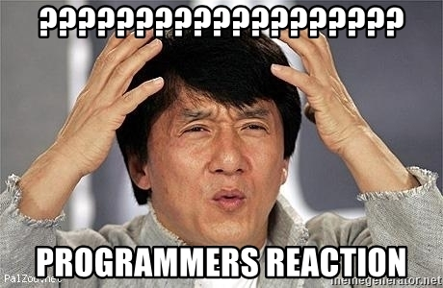
Now you got what a programming language is?

Slide 5
What is a Programming Language? (The Red Version)
A programming language is a formal language comprising a set of instructions that produce various kinds of output.
Programming languages are used in computer programming to implement algorithms.
Most programming languages consist of instructions for computers. There are programmable machines that use a set of specific instructions, rather than general programming languages.

Slide 6
1 What is a programming Language?
A language which is used to speak to a computer.
2 Why should I speak to a computer?
because you are a programmer and the computer does complex processing with relative ease.
3 Will they here if we speak?
Yes. They listen by the inputs provided by us(the programmers).
4 Will they respond back?
Of course, they respond by giving the output.
5. Why should I give input and get output from a computer?
Read the answer to the question number 2.

Slide 7
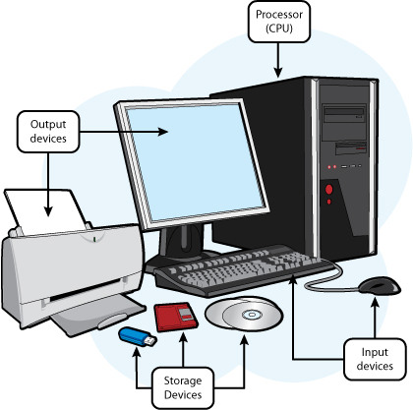
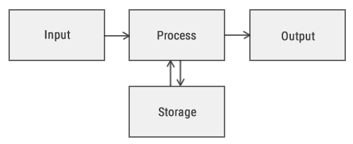
The processing is any program…

Slide 8
Let us consider the example of adding two numbers
Number1 = 10
Number 2 = 20
Total =Number1+
Number2
Output is 30
How do I give the input ??
By specific set of devices called as input devices. Example :Keyboard.
How will I get output?
Through specific set of devices called as output devices. Example :Monitor.
Though there may be several input devices the keyboard is defined as the standard input device and refereed to as “stdin”.
Though there are several output devices the monitor is defined as the standard output device and refereed to as “stdout”.

Slide 9
Programming Language and Program
A programming language is tool for writing programs that can be executed by a computer.
The program is a sequence of instructions executed together to accomplish a task.
Functions a smaller sub units of a larger program. Sometime complex tasks will be divided into smaller tasks called as functions.
The sequence of instructions are also referred as code.

Slide 10
Grammatical Structure of a Programming Language
Any natural language (English) is used for communication between two humans.
Any natural language will have a legal set of symbols called alphabets, words and grammatical rules.
Every programming Language also has legal set of symbols, words and grammatical rules.
The Grammatical rule of a programming language is called as Syntax.
Each programming language has different set of syntax.

Slide 11
Let us try converting the program to add two numbers into a sequence of dummy instructions - Algorithm
Start
Enter first number to add.
Enter second number to add. These two are input statements.
Add the two numbers. This is the processing statement.
Display the result in the monitor. This is the output statement
Stop.
The above instructions are dummy and does not belong to any programming language.
These kind of programs are called as algorithms.
The algorithm can be converted into a program using any programming language.

Slide 12
Semantics of programming Language
Semantics is synonymous to Meaning or Logic
Sometimes programmers write a statement which is correct in syntax but has no meaning.
Theses kind of sentence said to have semantic error (hold no meaning)
Meaning ???
Let us consider the mathematical operator “+”
In C language 10+20 =30 and Hindustan + University is error
In Python Language 10+20 =30 and Hindustan + University is Hindustan University.
The programmer should understand these programming language specific nitty-gritty

Slide 13
General Structure of a programming Language
Set of statements to include library function – Library functions are inbuilt functions and ready to use functions .
Example: printf() function in C language is used for displaying anything in the monitor.
Sequence of instructions to perform a particular task ex: adding two numbers.
Set of instructions to display the output.

Slide 14
General Structure of a programming Language of a simple calculator
Set of statements to include library function
Function to adding two numbers.
Function to Subtracting two numbers.
Function to Multiplying two numbers.
Function to Dividing two numbers.
The main functions which executes all the above functions

Slide 15
Compiling a program
#include<stdio.h>
int main ()
{
printf(“welcome to the world of programming”);
}
The above code is a sample C code – “if you can read and undrstand this program, computer cannot read and understand this program because this program is still in human readable format”.
The above program need to be converted/translators into a machine readable format.
The process of converting the human readable program (high level language) to a computer/machine readable format is called as compilations.
The above process will be performed by a tool/software called compiler.
Every programming language will have its own compiler.
The legitimacy of the words symbols and grammatical rule compliance will be checked by compilers.

Slide 16
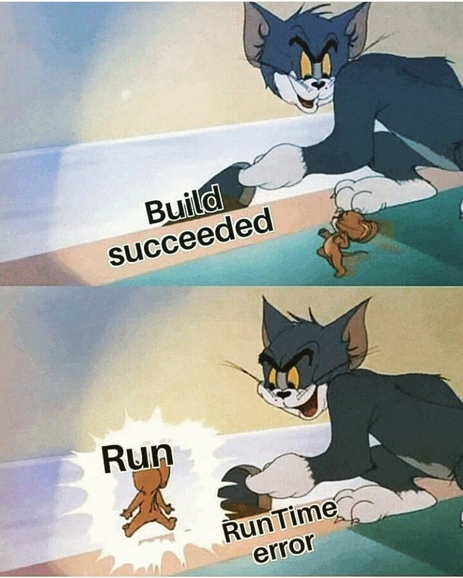
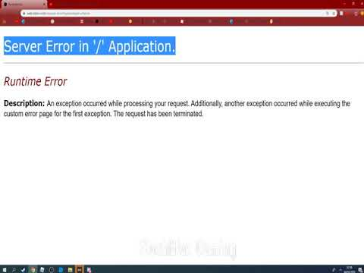
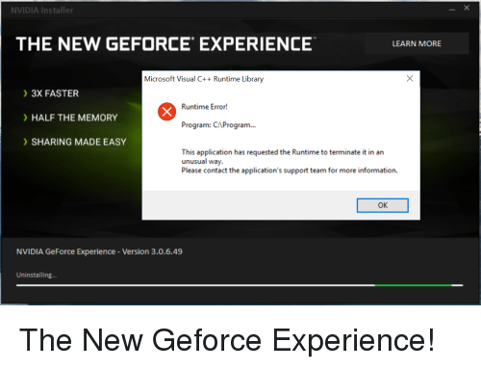
Executing a Program- Run Time Considerations
Once the program is compiled the program is ready to run/executed.
Some programs which are successfully compiled will create errors during execution. These errors are called as runtime errors.

Slide 17
Executing a Program- Run Time Considerations
Some programming languages are Operating System(OS) specific.
if we compile the program in windows OS then the program can be executed/used only in windows OS. Example : C language.
Some programming languages are Operating System(OS) independent.
if we compile the program in windows OS then the program can be executed/used in any OS. Example : Java

Slide 18
Why are there so many programming languages?
Why does some people speak French?
Programming languages have evolved over time as better ways have been developed to design them.
First programming languages were developed in the 1950s
Since then thousands of languages have been developed
Different programming languages are designed for different types of programs.
It could be due to evolution
Or Special Purpose.
Personal Preferences.

Slide 19
Different Types of Programming Domains?
Scientific applications
Business applications
Artificial intelligence
Systems programming
Scripting languages
Special-purpose languages

Slide 20
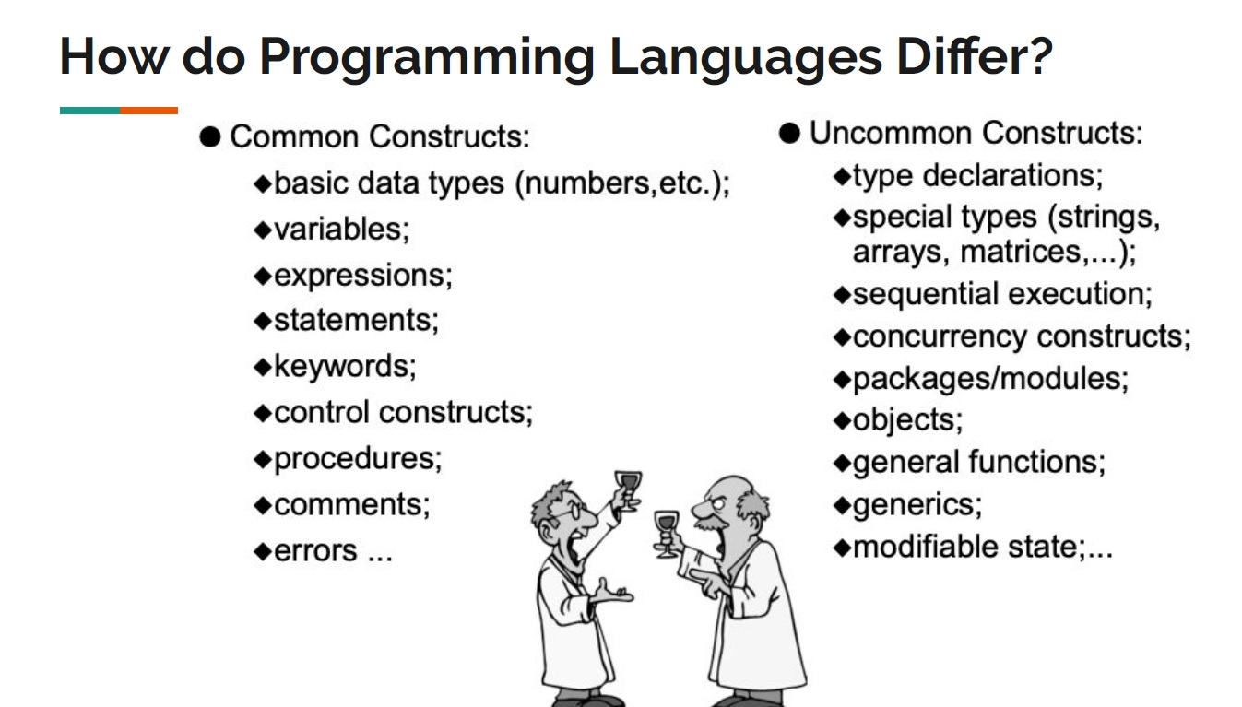

Slide 21
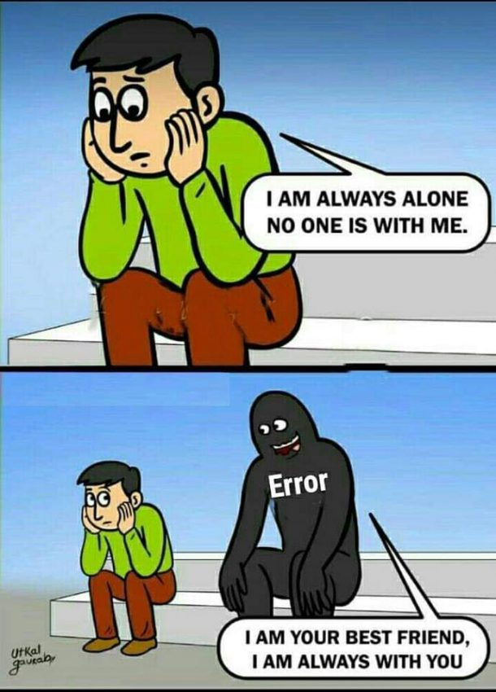
Myths
I belong to biology group in school, so I cannot learn programming.

Slide 22
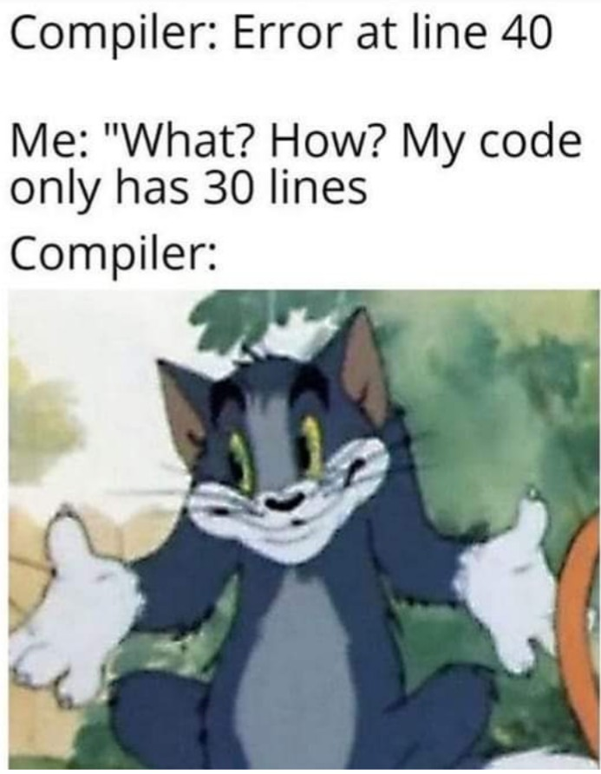
Myths
My programs never gets compiled in first time.

Slide 23
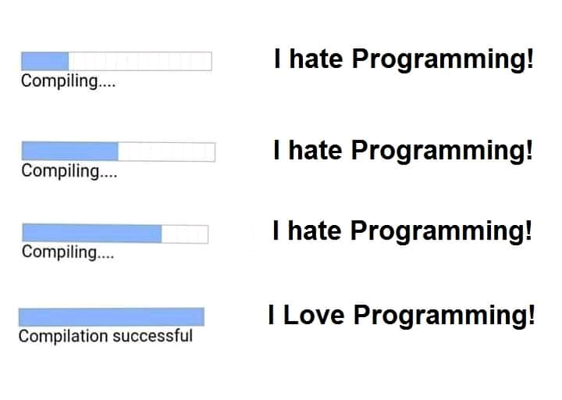
Myths
I hate programming it is like mathematics to me..

Slide 24
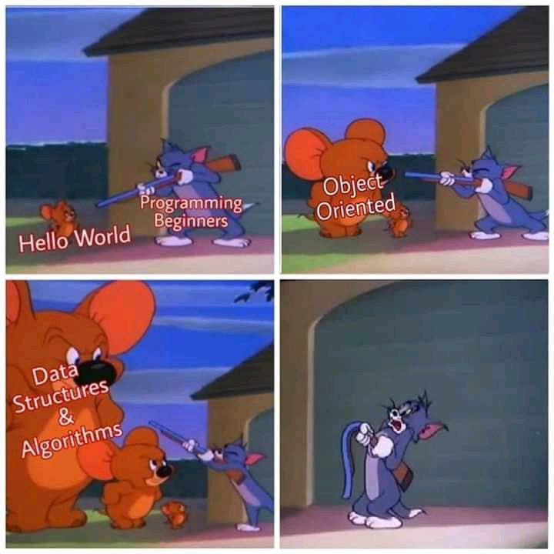
Myths
Brisk effervescence

Slide 25
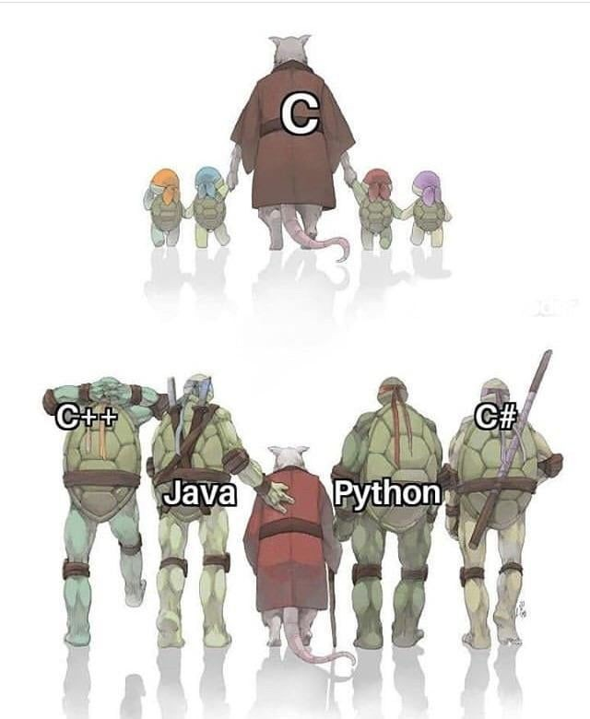
Myths
Nobody need to understand the basics of programming languages, we just start developing that mobile app.

Slide 26
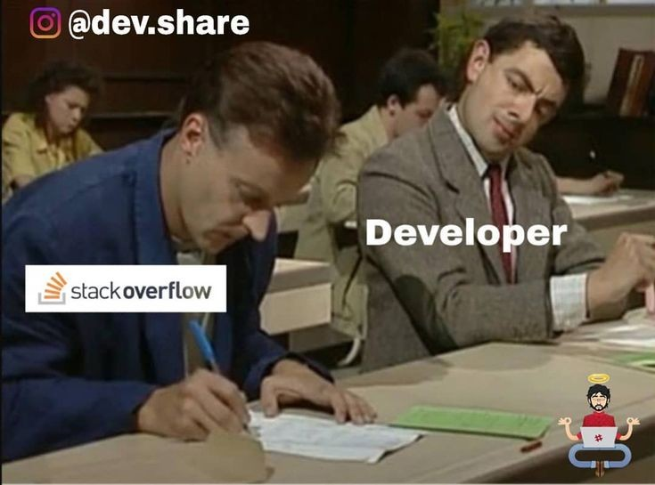
Myths
Most of the programmers just download the codes and reuse them as per their requirement.

Slide 27
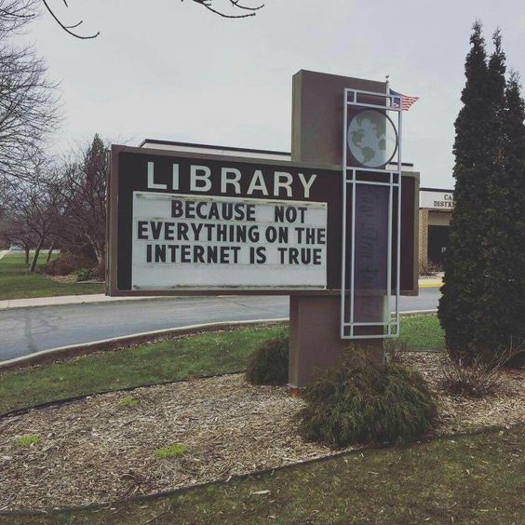
Myths
All stuff related to computer science is available in internet

Slide 28
Thank You .. Have a Great Day

